Slide 1
Bankruptcy Prevention
Project Mentor: Neha Ramchandani
Group Members:1.Omkar Bhagwat
2.Chaitravi Angane
3.Manju Kiran
4.Akarsh Bhasi
5.Yogita Mishra
6.Amrut Vishwaroop
P-138
Date: 17/07/2022

Slide 2


Business Problem:
To Identify whether business going to bankrupt or not
Objective:
This is a classification project
The variable to predict is binary (bankruptcy or
non-bankruptcy).
The goal here is to model the probability that a business goes
bankrupt from different features.
The data file contains 7 features about 250 companies

Slide 3
Project Flow:
.

Slide 4
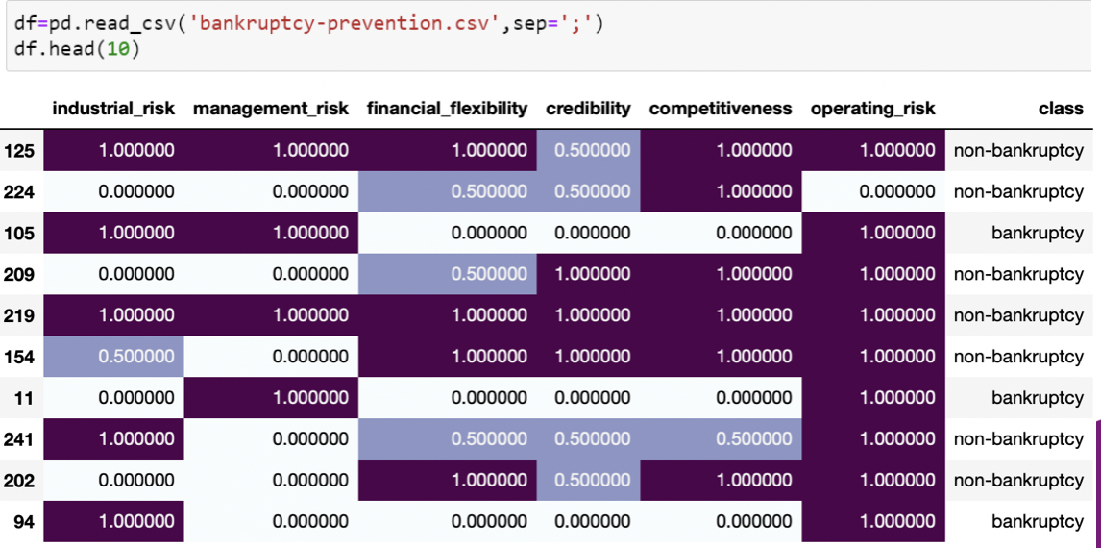
Dataset:
The data set includes the following variables:
industrial risk: 0=low risk, 0.5=medium risk, 1=high risk.
management risk: 0=low risk, 0.5=medium risk, 1=high risk.
financial flexibility: 0=low flexibility, 0.5=medium flexibility, 1=high flexibility.
credibility: 0=low credibility, 0.5=medium credibility, 1=high credibility.
competitiveness: 0=low competitiveness, 0.5=medium competitiveness, 1=high competitiveness.
operating risk: 0=low risk, 0.5=medium risk, 1=high risk.
class: bankruptcy, non-bankruptcy (target variable).

Slide 5
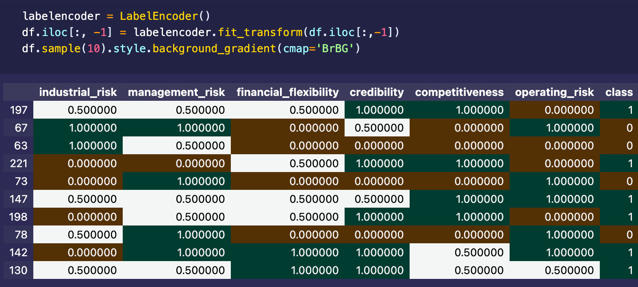
Label Encoding:
As we know that Machine Learning models can only handle numeric features, hence categorical and ordinal data must be somehow converted into numeric features

Slide 6
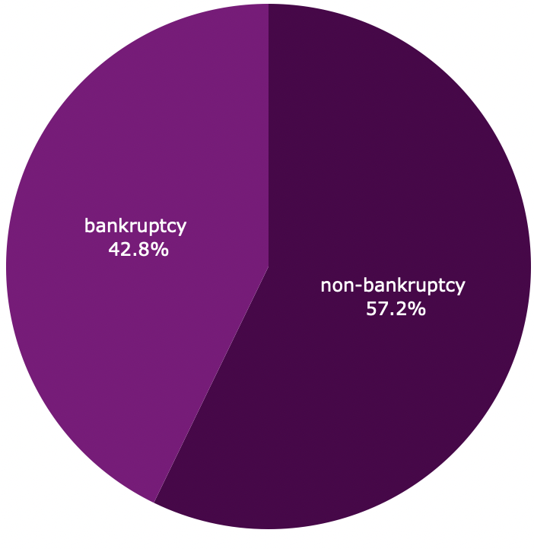
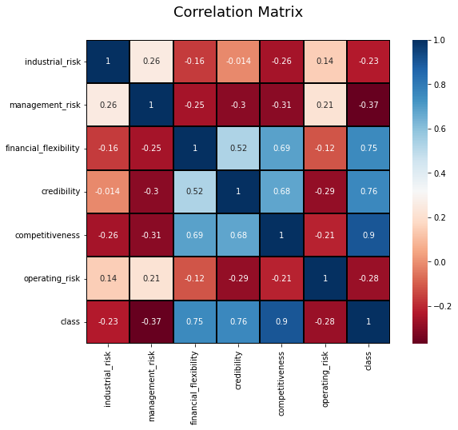
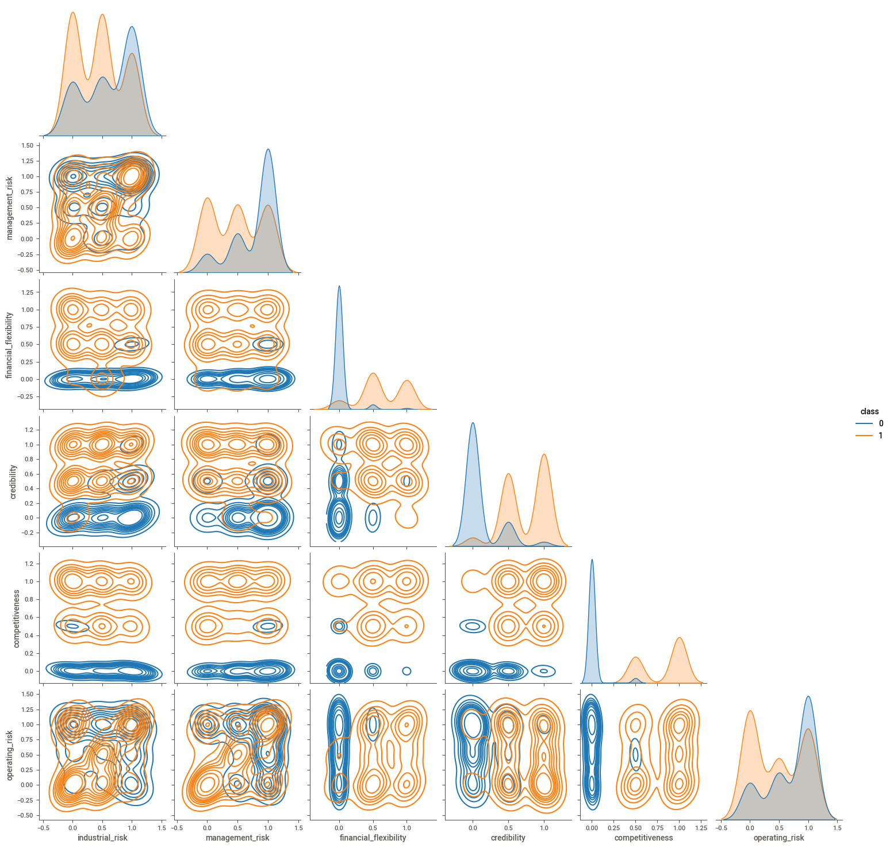
Visualisation :

Slide 7
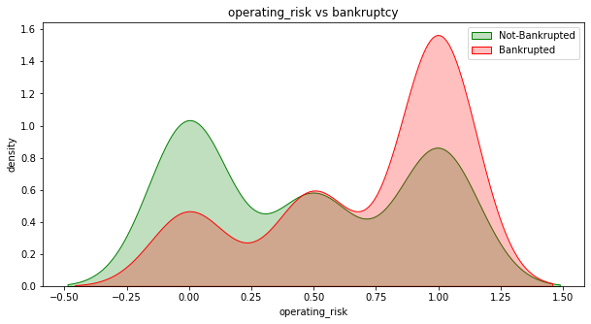
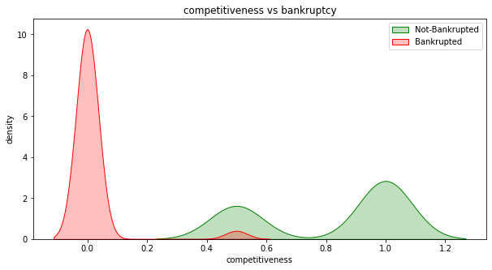
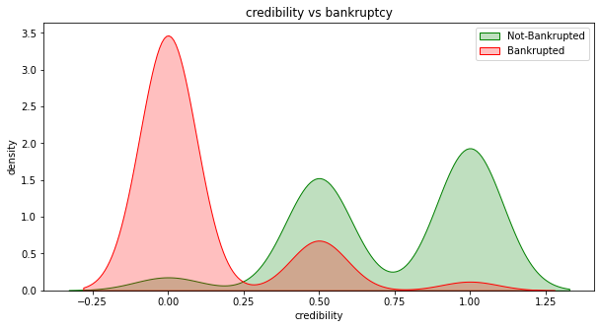
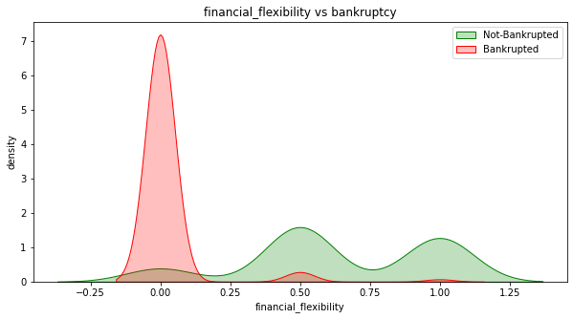
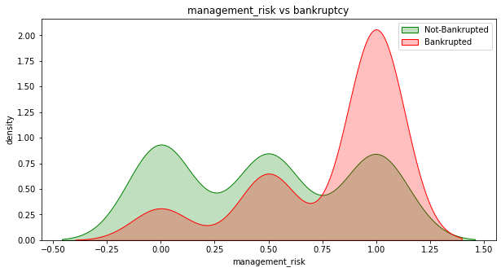
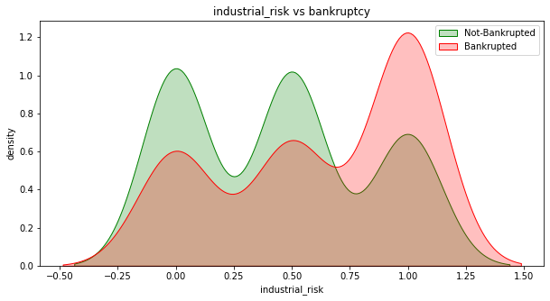
Insights:
Density Plot of Operating Risk
Density Plot of Competitiveness
Density Plot of Credibility
Density Plot of Financial Stability
Density Plot of Management Risk
Density Plot of Industrial Risk

Slide 8
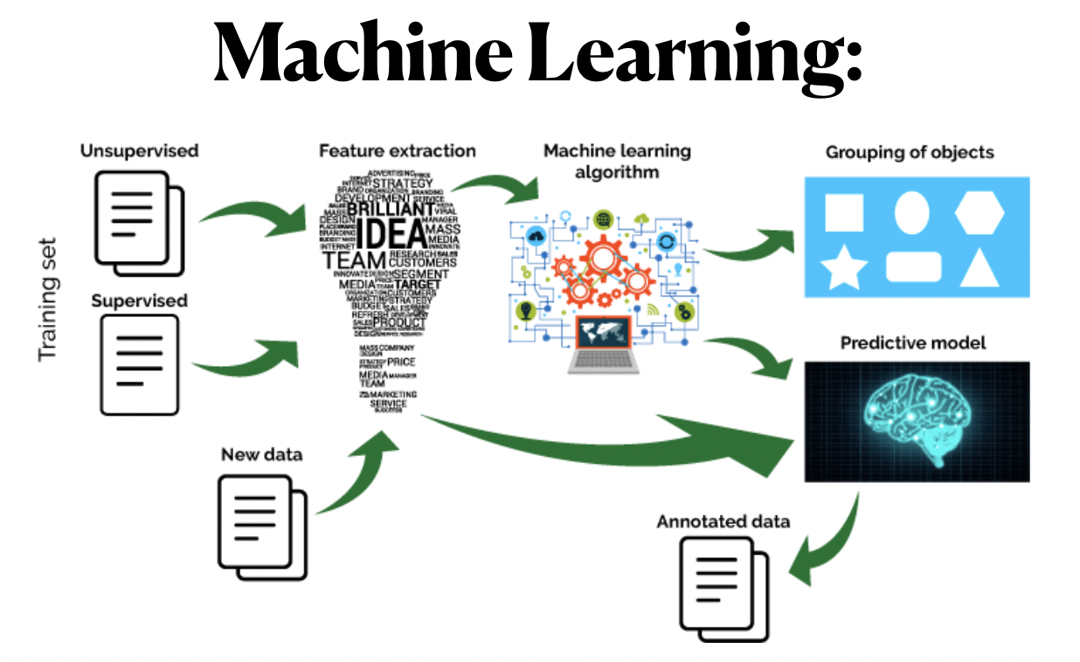

Slide 9
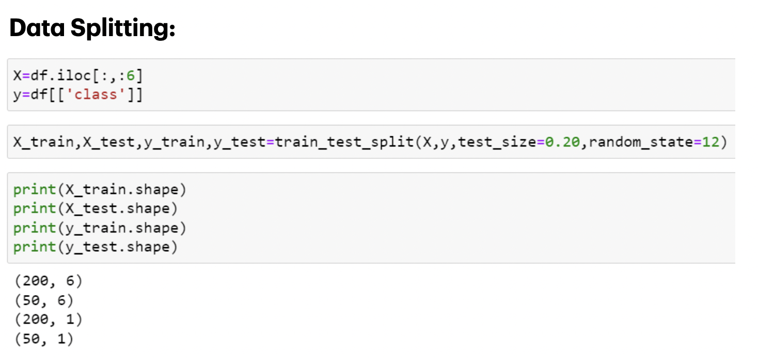
Model Building:

Slide 10
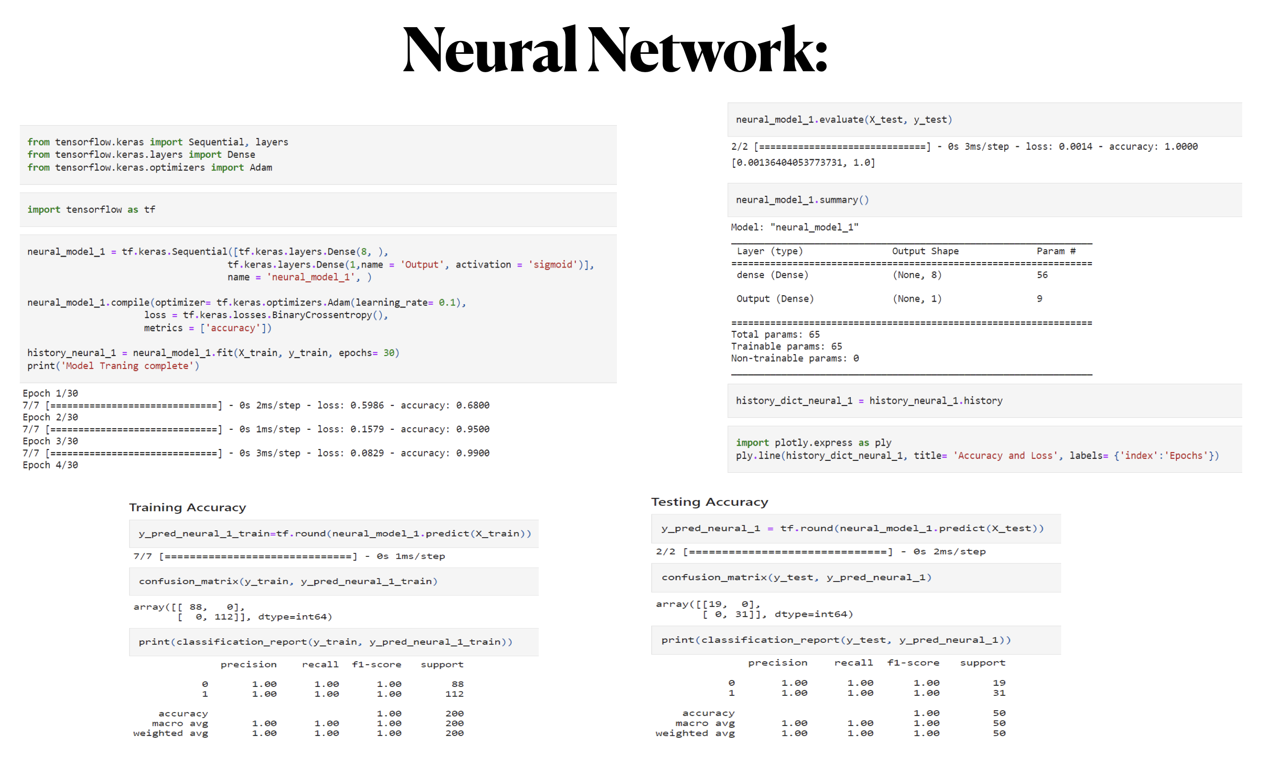

Slide 11
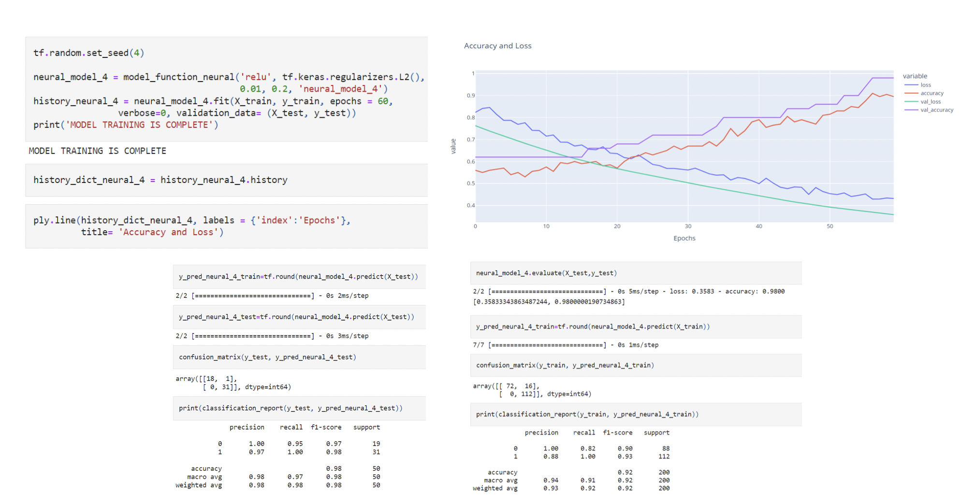

Slide 12
Diffrent Algorithm:
Logistic regression
Random forest
Neural Network
Gaussian Naive Bayes
Ada boost
Decision Tree
SVM
Naïve Bayes
KNeighborsClassifier
Perceptron

Slide 13
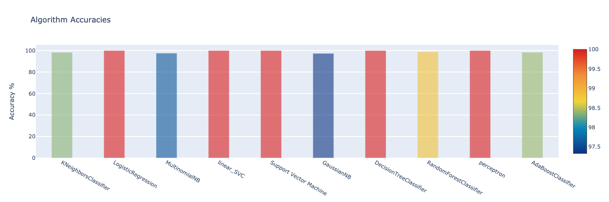
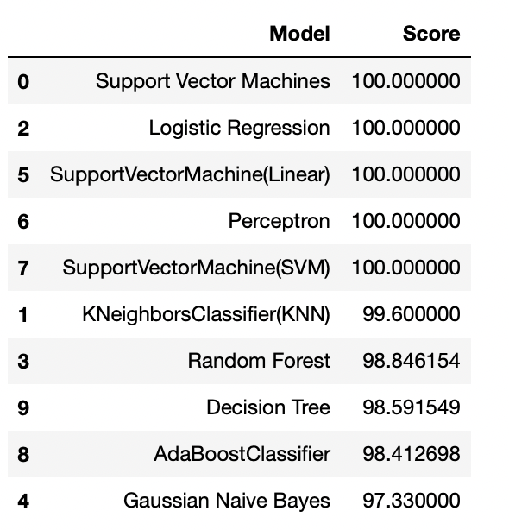
Model Accuracy:

Slide 14
Model Deployment
Using Streamlit

Slide 15

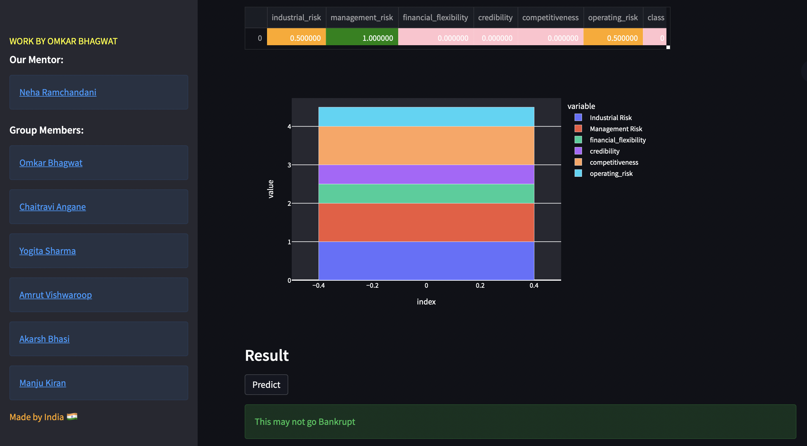

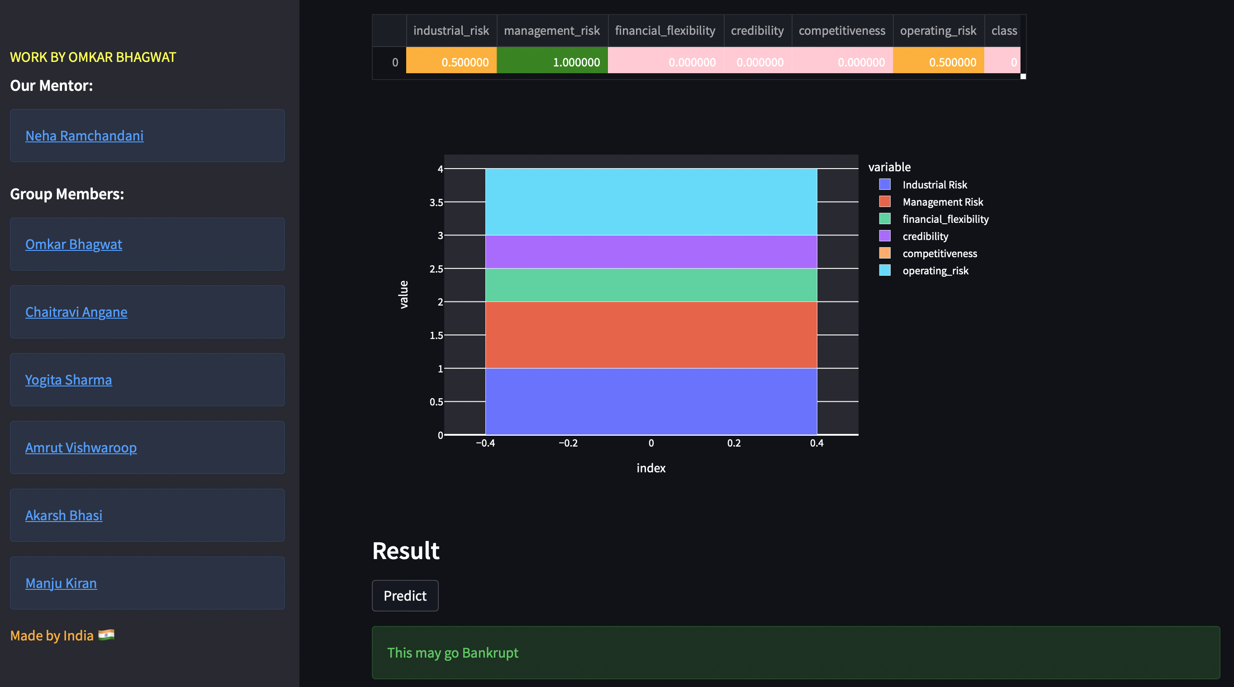
Bankrupt or Not Bankrupt

Slide 16
Thank You!

